Slide 1
COVID-19 ANALYSER
P1 Group 6
Jullisha(2201853), Vivian(2203557),
Yok Hung(2202391), Rasheed(2203385)
Jackson(2202871)

Slide 2
BACKGROUND
COVID-19 is a viral infection caused by the SARS-CoV-2 virus.
Because it is easily transmitted via airborne particles and droplets, it is considered a global pandemic.
Total death cases worldwide, approximately 6.5 million
Countries impose strict restrictions to stop the disease's spread
Notes:
COVID-19 has become a global pandemic and is affecting all nations worldwide. The emerging threat posed by the COVID-19 pandemic has affected every aspect of our lives, including our lifestyle, economy, social fabric, and healthcare sector. The governments and other countries have been working together to fight this tough battle.

Slide 3
COVID-19 IMPACTS
01
02
03
04
RETRENCHMENT
VACCINATION
RETRENCHMENT RATE
VACCINATION RATE
VACCINE CLINICS IN SINGAPORE
VACCINATION HESITANCY
HAPPINESS
VACCINATION-RELATED MORTALITY RATE
COVID-19 MORTALITY RATE (VACCINATED)
WORLD HAPPINESS AND COVID-19

Slide 4
PURPOSE
Provide users with a better understanding of the COVID-19 situation.
Benefit:
Determine what potential jobs users can look for during the pandemic.
Determine whether vaccination affects the mortality rate.
Encourage users to get vaccinated in order to be more protected against COVID-19.
Learn about the vaccination rates in different countries (vaccinated and fully vaccinated)
Provide information on the Public Health Preparedness Clinics (PHPC) in Singapore.

Slide 5



SYSTEM DIAGRAM
STAGE 1
Choose appropriate data and journals (Find datasets)
STAGE 2
Pre-processing of data and journals (Cleaning & Filtering)
STAGE 3
Data analysis through the use of various algorithms and machine learning
STAGE 4
Upload the final result to the web app

Slide 6
METHODS
Linear regression (Machine learning)
Pearson Correlation heatmap
Bar charts
REASONS
To determine which variables are related to one another
To comprehend the magnitude of the variable relationship

Slide 7
01
RETRENCHMENT

Slide 8
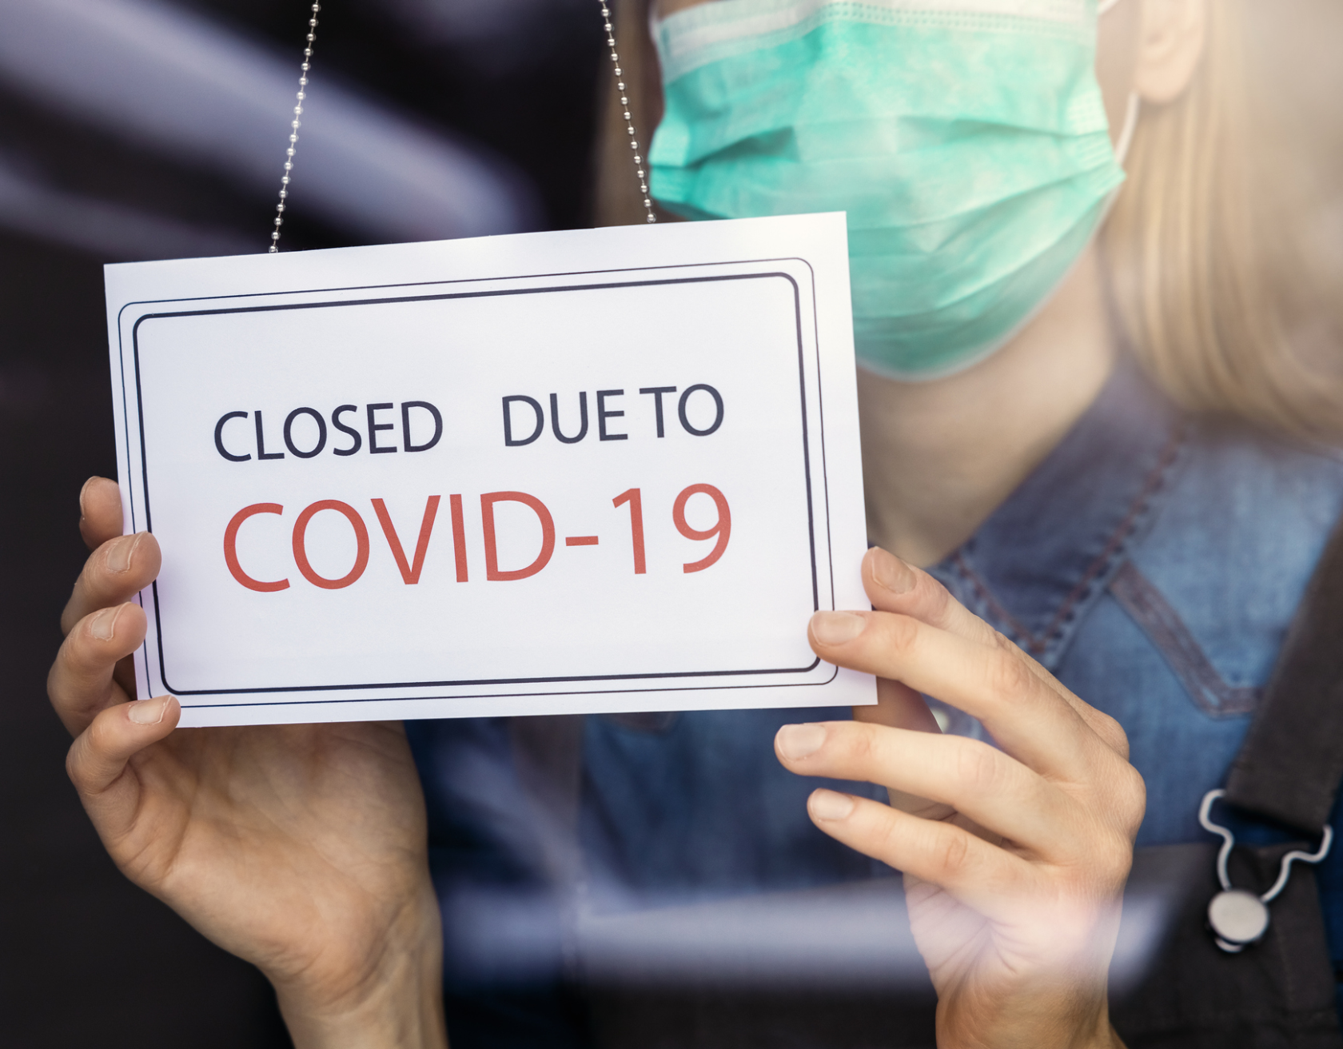


WHY RETRENCH?
Tight restrictions imposed which includes workplace closures
Resulting in loss of revenues for companies
Therefore, to keep the business going, companies resorted to retrenchment to cut down on expenses
Notes:
Have u ever wondered if the measures imposed by the government has caused a high retrenchment rate in singapore

Slide 9
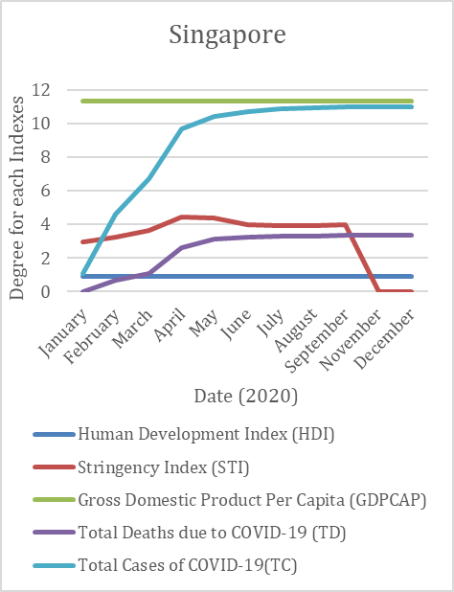
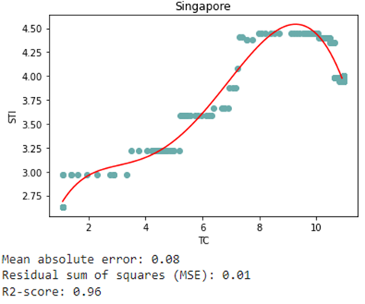
RELATIONSHIP BETWEEN TC AND STI
Polynomial Regression
R2-score is high
Mean absolute error is low
TC/TD and STI have some patterns
Notes:
Observations made:
TC/TD and STI have some patterns
Other variables only shows constant values, making it not applicable to study the effects of COVID-19

Slide 10
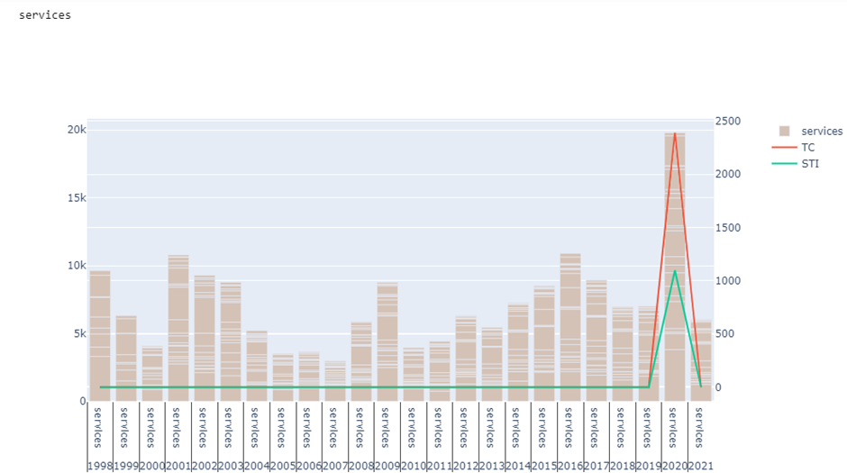
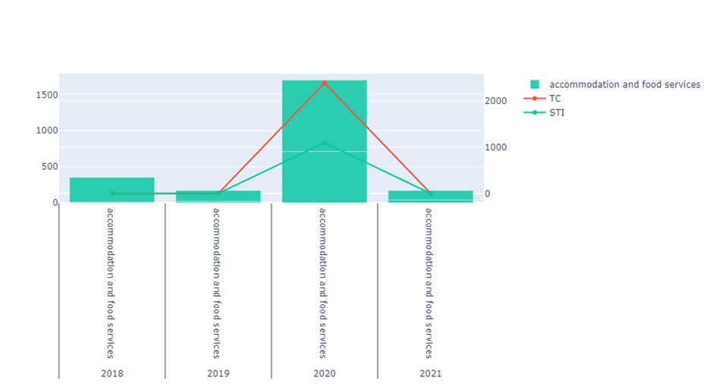






RETRENCHMENT RATE BY INDUSTRY
Services sector can be further branched out as accomodation and food services
A sharp increase in retrenchment rate along with STI and TC
Notes:
Have u ever wondered if the measures imposed by the government has caused a high retrenchment rate in singapore

Slide 11
02
VACCINATION

Slide 12
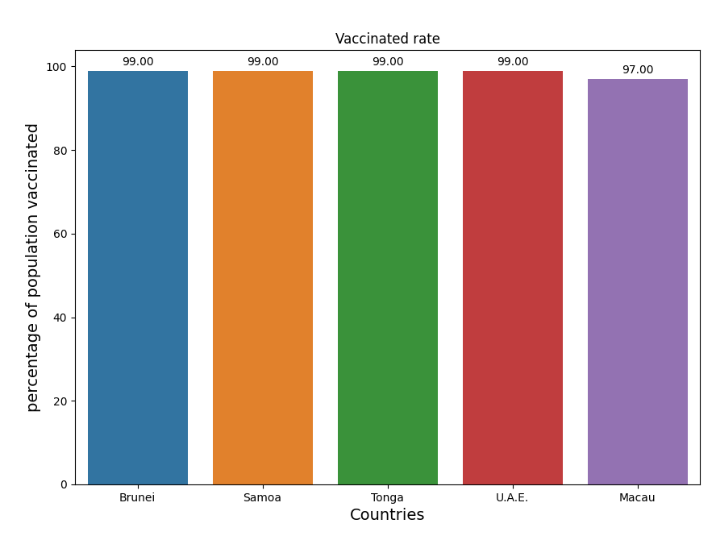
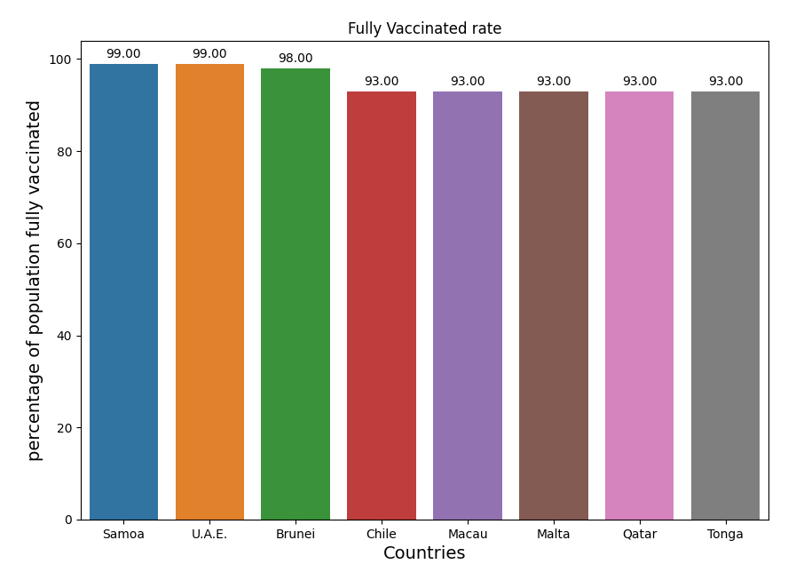
VACCINATION RATE - WORLD
HIGHEST VACCINATED RATE
HIGHEST FULLY VACCINATED RATE
Comparing the countries and percentage, observations are:
Ranking for some countries changed
The percentage for fully vaccinated rate is generally lower than vaccinated rate

Slide 13
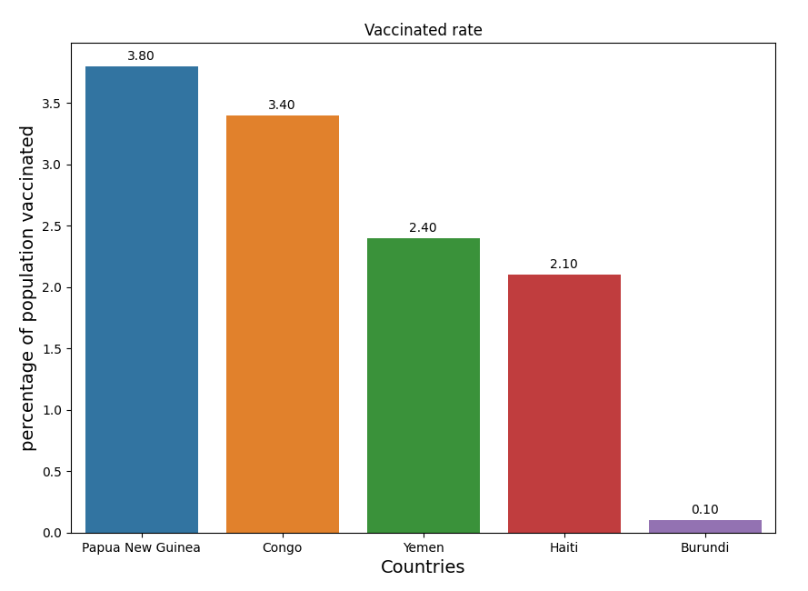
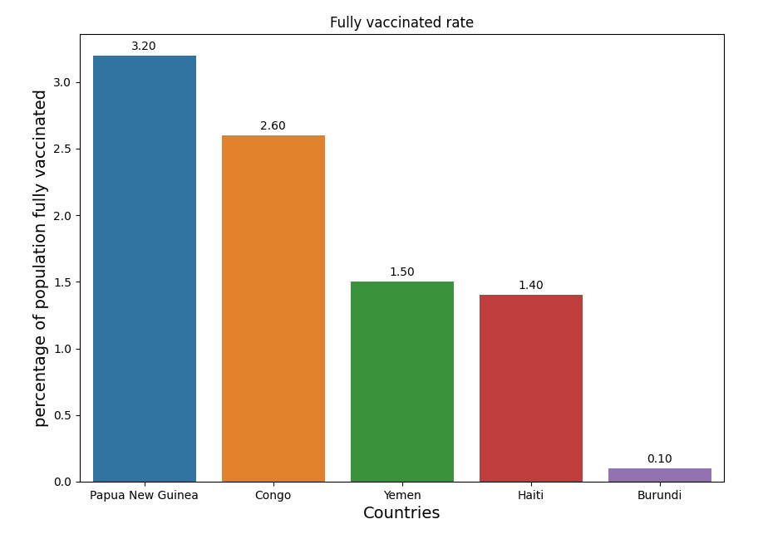
VACCINATION RATE - WORLD
LOWEST VACCINATED RATE
LOWEST FULLY VACCINATED RATE
Comparing the countries and percentage, observations are:
The percentages for fully vaccinated rate is lower than vaccinated rate
Rankings did not change

Slide 14

VACCINATION RATE - SINGAPORE
Observations:
Singapore achieved the same percentage for both vaccinated and fully vaccinated
Greater efforts could be made to increase the vaccination rate for Singapore’s population

Slide 15
VACCINES IN SINGAPORE
PHPC CLINICS
PFIZER/COMIRNATY
Available for Adults and Children aged 5 to 11 years old
SINOVAC
NOVAVAX

Slide 16
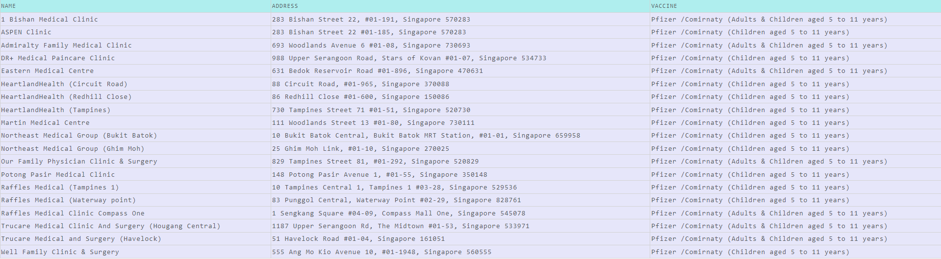
PFIZER / COMIRNATY FOR CHILDREN
Total: 19 clinics

Slide 17
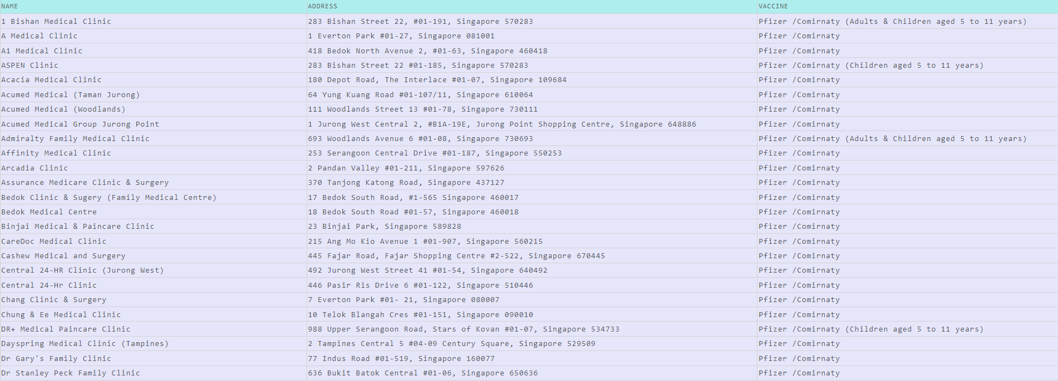
PFIZER / COMIRNATY FOR ALL
ABSTRACT
Total: 162 clinics

Slide 18
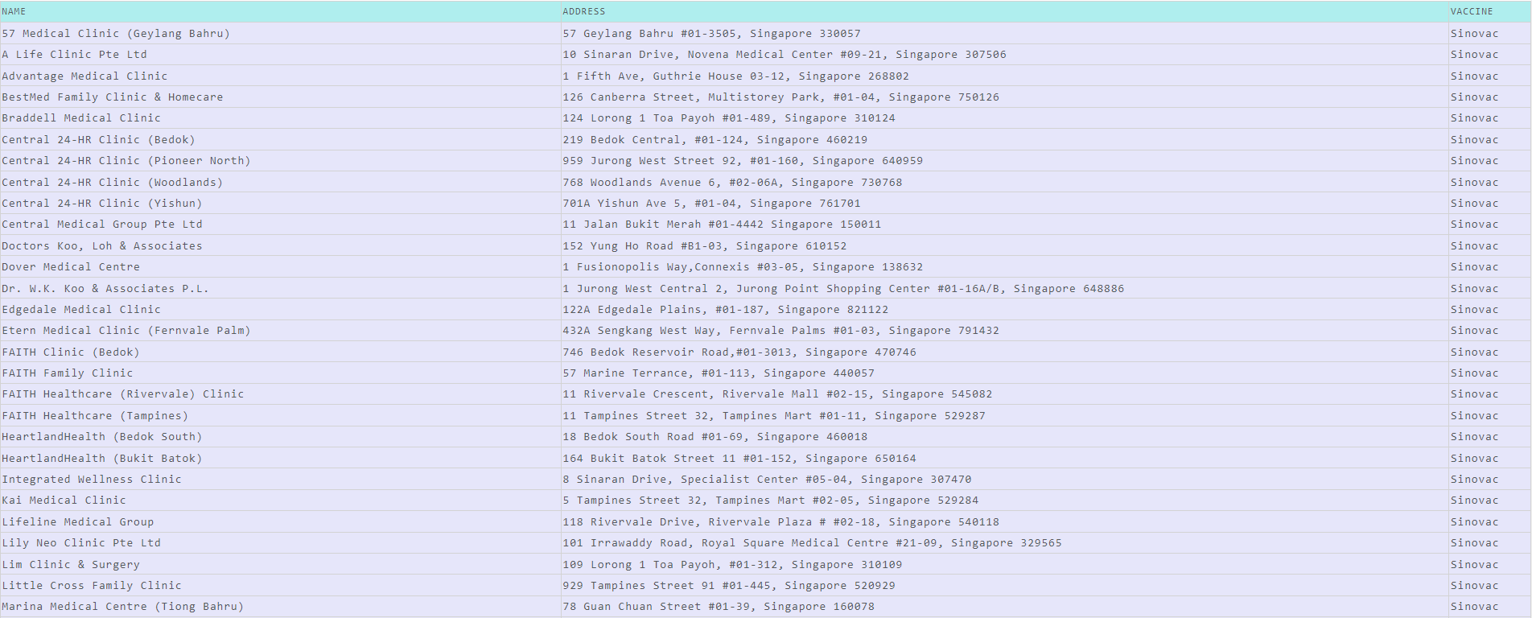
SINOVAC
ABSTRACT
Total: 39 clinics

Slide 19
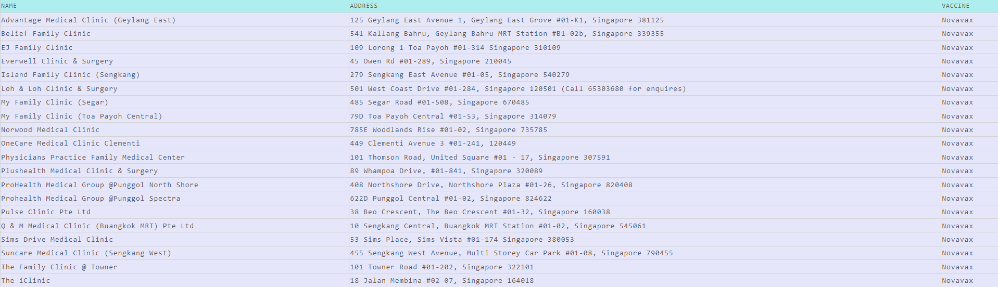
NOVAVAX
Total: 20 clinics

Slide 20
03
VACCINATION HESITANCY

Slide 21
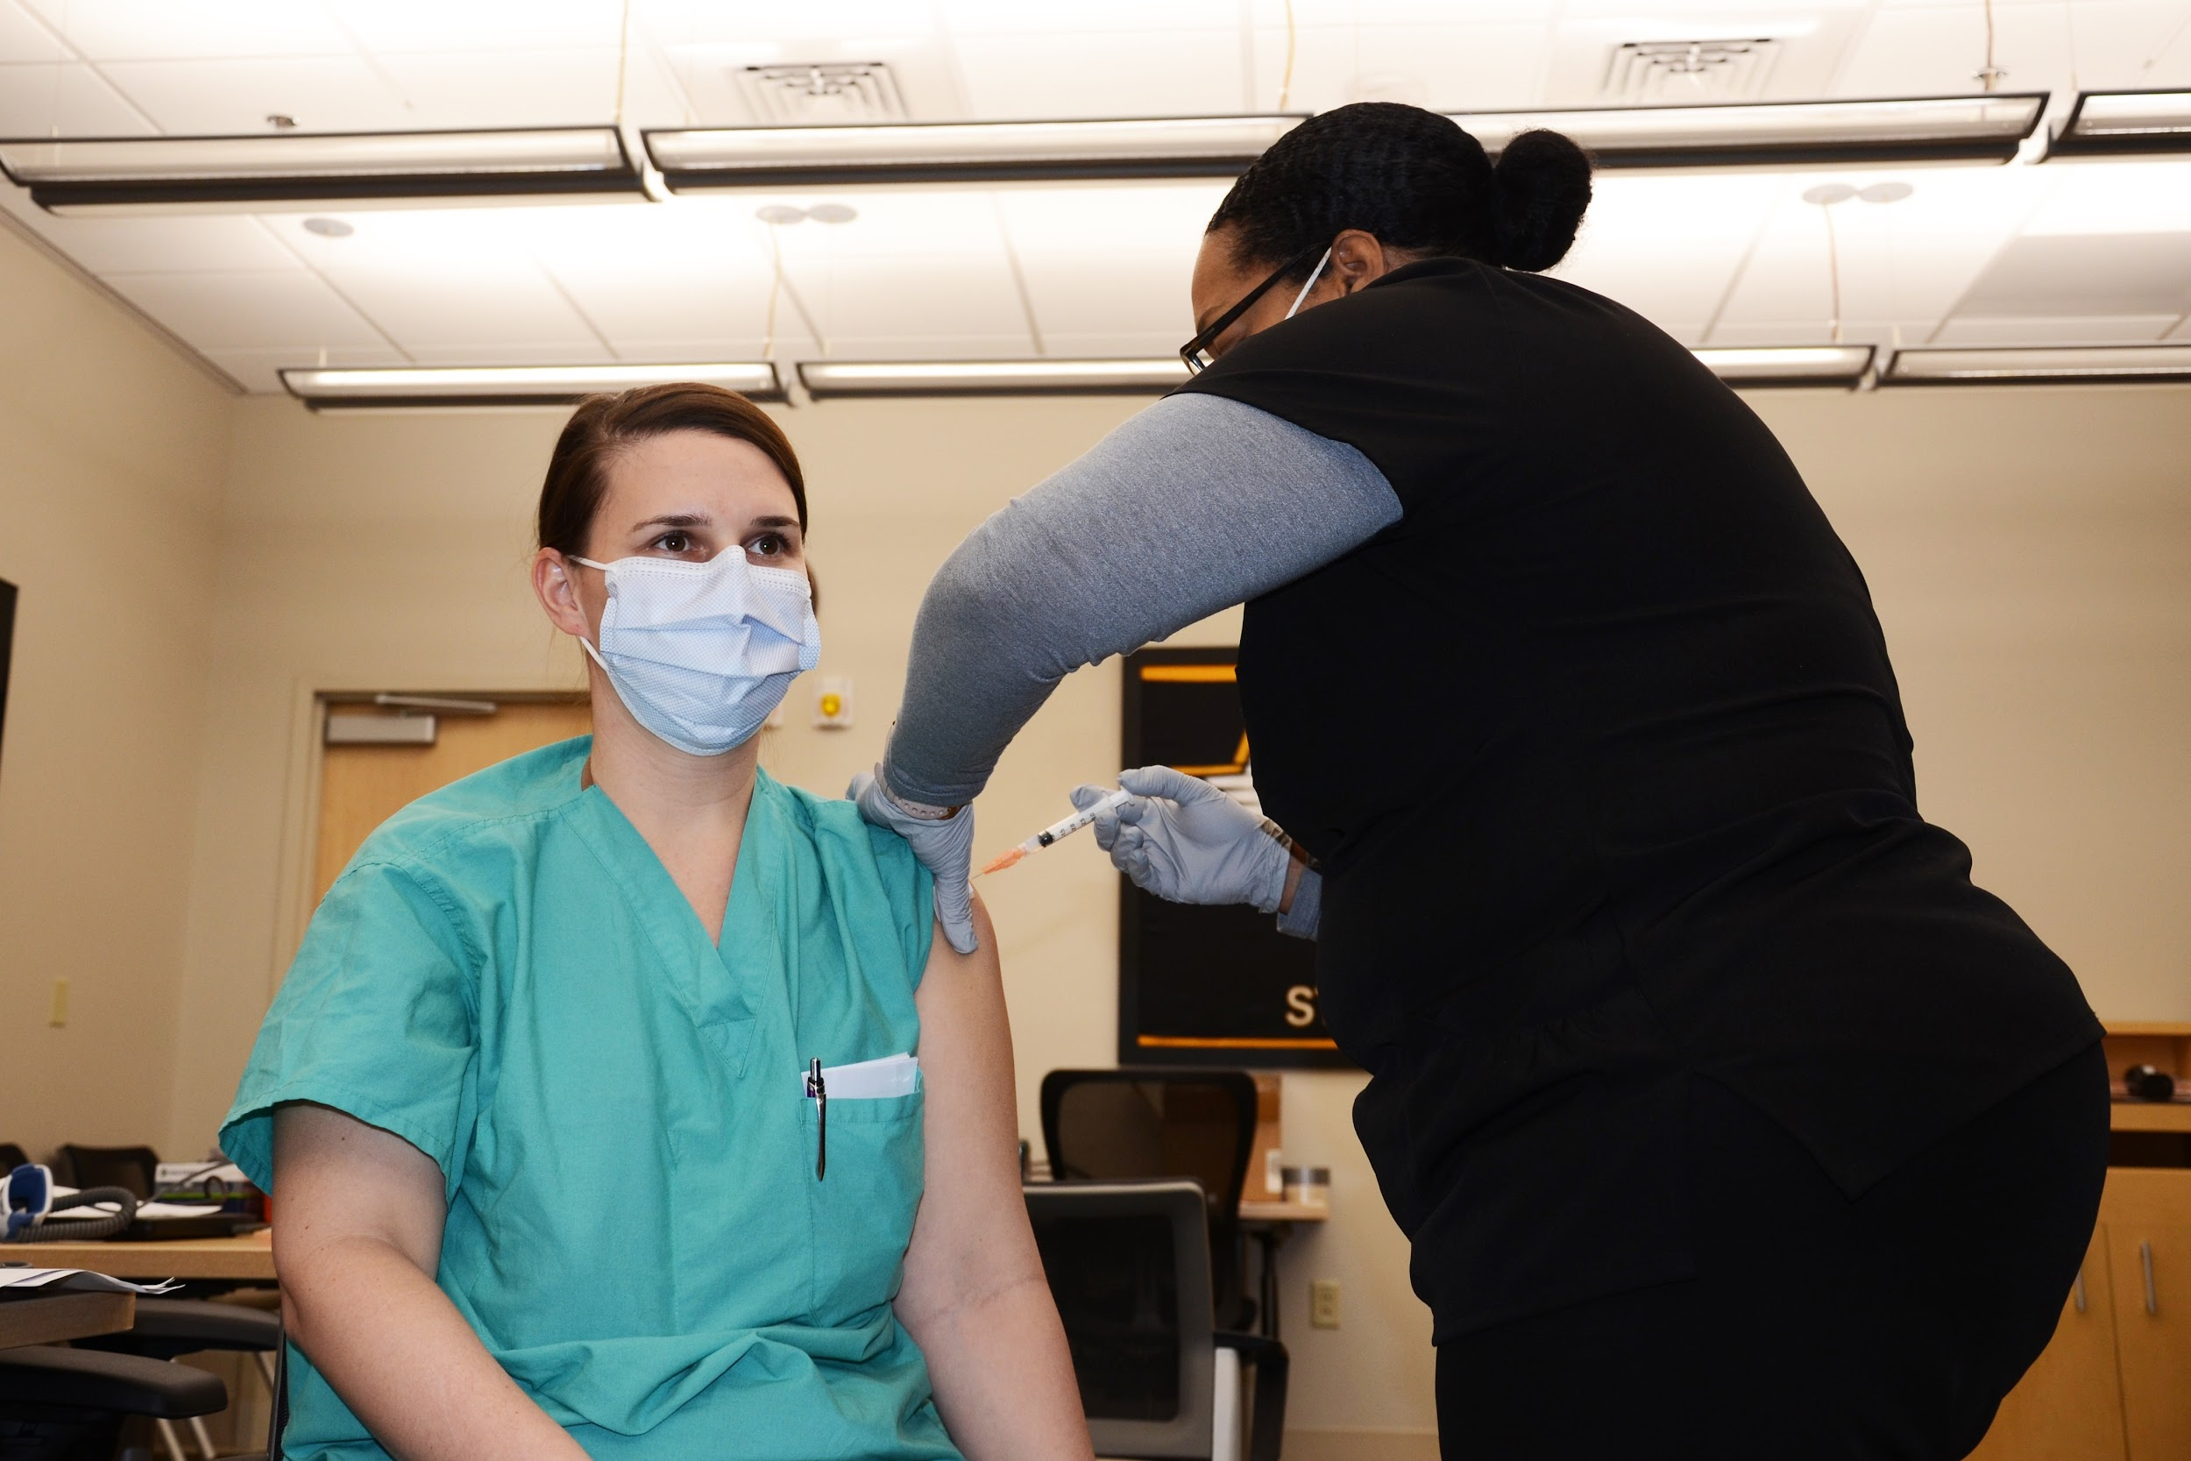
BENEFITS OF COVID-19 VACCINATION
It helps to protect you from disease
Reduce the possibility of transmission
Keeps our healthcare system from becoming overstretched

Slide 22
FOOD FOR THOUGHT
Why are people still refusing to get vaccinated?
Despite the fact that it is:
Easily accessible to vaccination services
Vaccines that have been thoroughly tested in multiple clinical phase trials
Safe and high-quality healthcare services for post symptoms

Slide 23
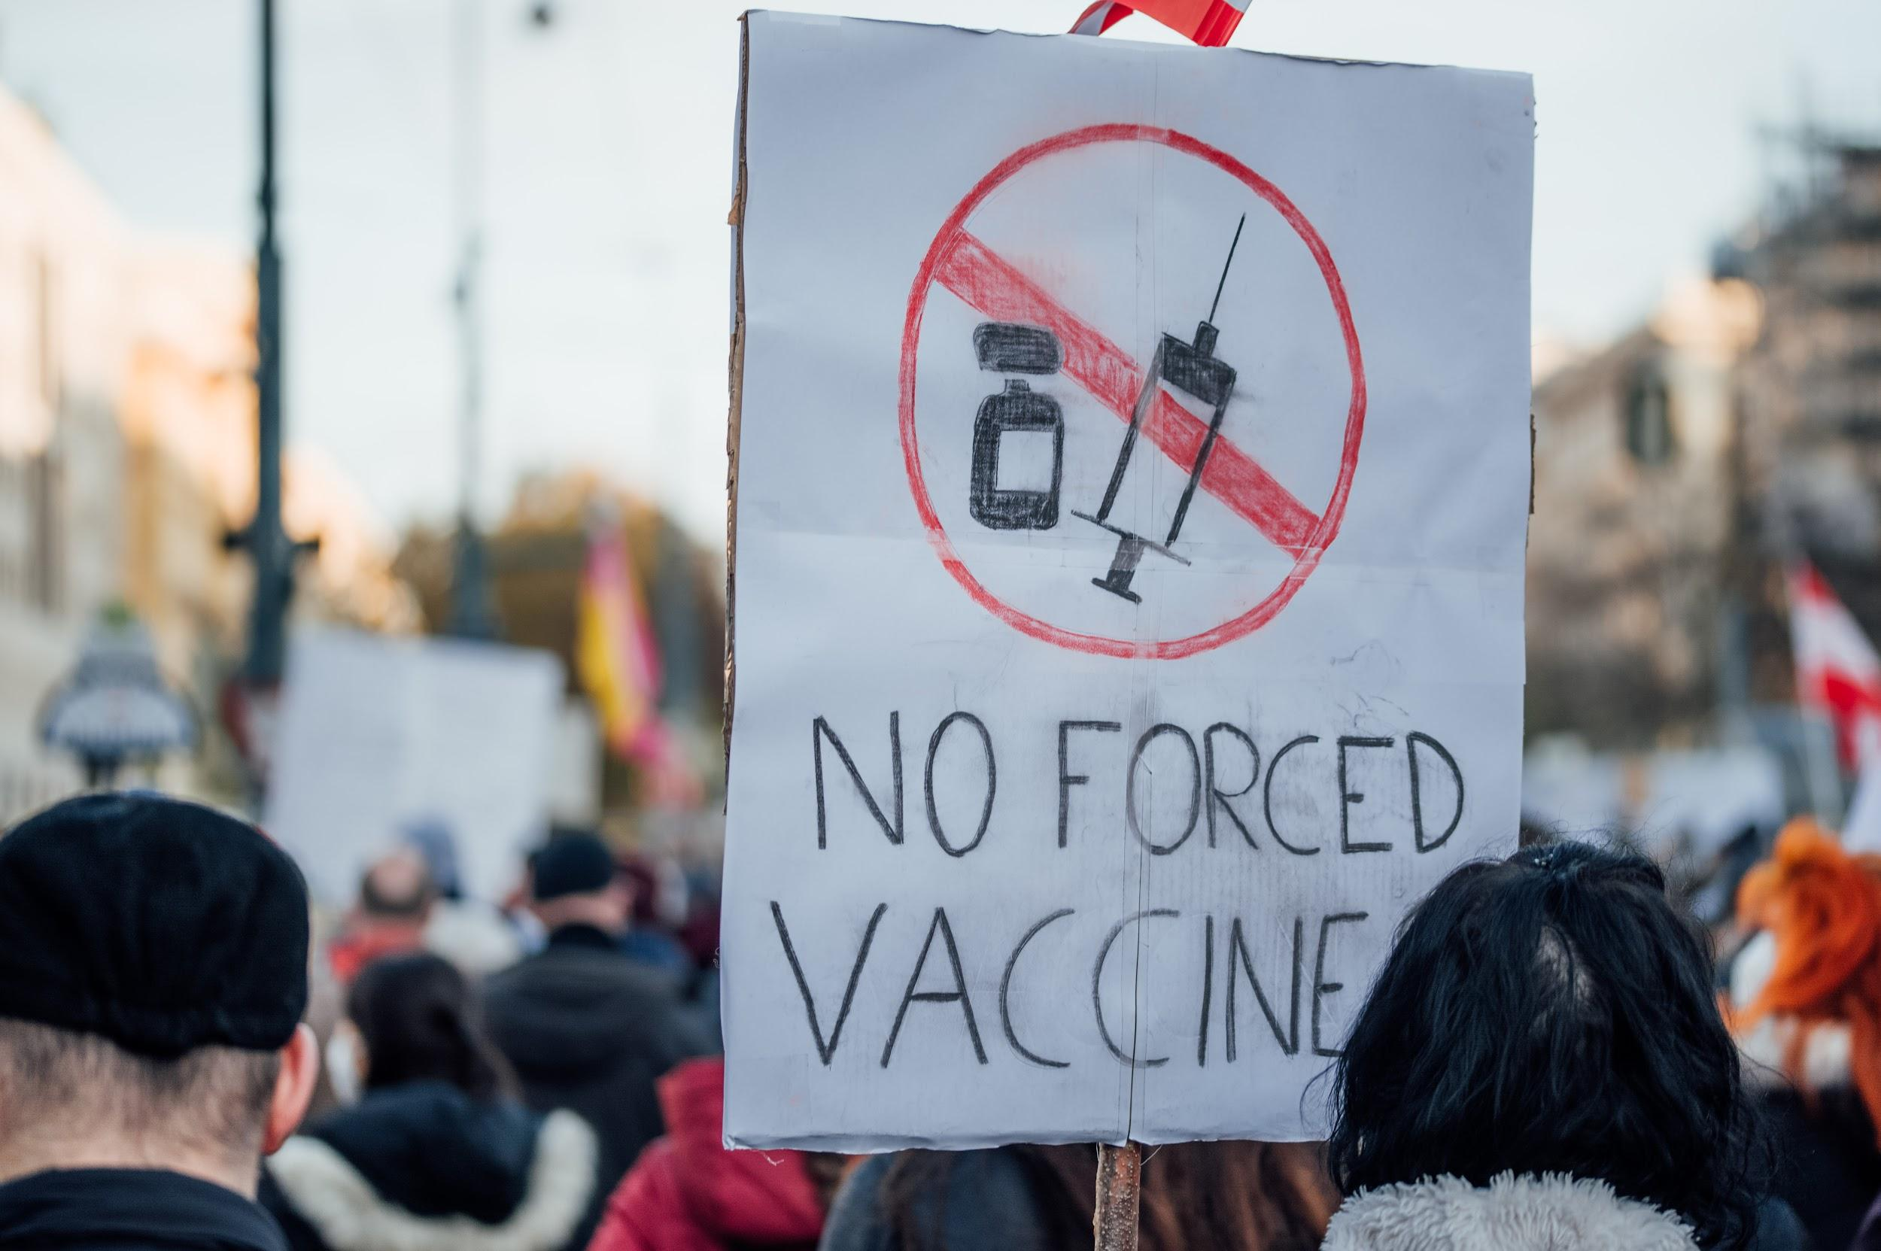
REASONS TO REFUSE VACCINATION
The vetting phase trial is moving too quickly.
a lack of confidence in vaccine safety
Unaware of the significance of vaccination
Feel that the vaccine is ineffective.

Slide 24

WAYS TO PROMOTE VACCINATION
Use visuals to demonstrate clear and easy-to-understand results
Show the mortality rate from
COVID-19 disease after vaccinating
COVID-19 Vaccine

Slide 25
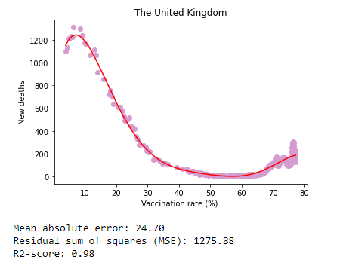

RATE OF MORTALITY VS VACCINATION
Case study
Observations
R2-Score is high
Mean absolute error is low
Mean square error is low
Data points are non-linear
‘Curve’ shape
More deaths despite higher vaccination rate

Slide 26
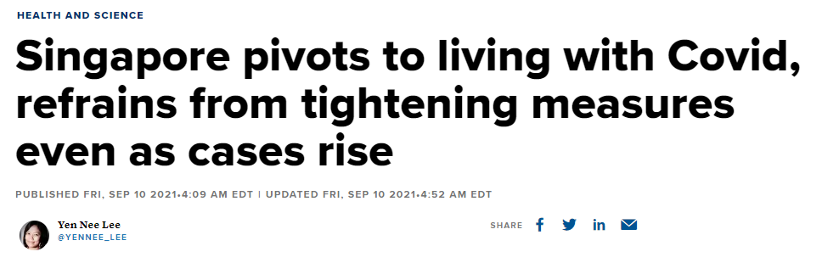
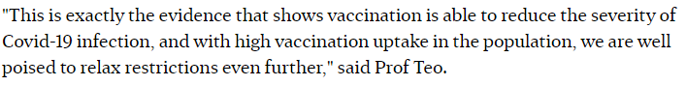
MORE DEATHS DESPITE HIGHER VACCINATION RATE
COVID-19 outbreak has an erratic pattern
Abstract article by experts in Singapore

Slide 27
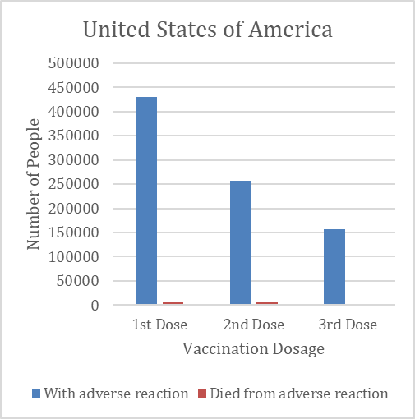
COVID-19 VACCINE RELATED MORTALITY RATE
Observations
A small percentage of vaccine-related deaths occur.
Benefits of vaccination
Defend people from disease
Reducing the risk of transmission
Keeping the healthcare system from becoming overburdened

Slide 28
04
WORLD HAPPINESS & COVID-19

Slide 29



World Happiness Report

Slide 30
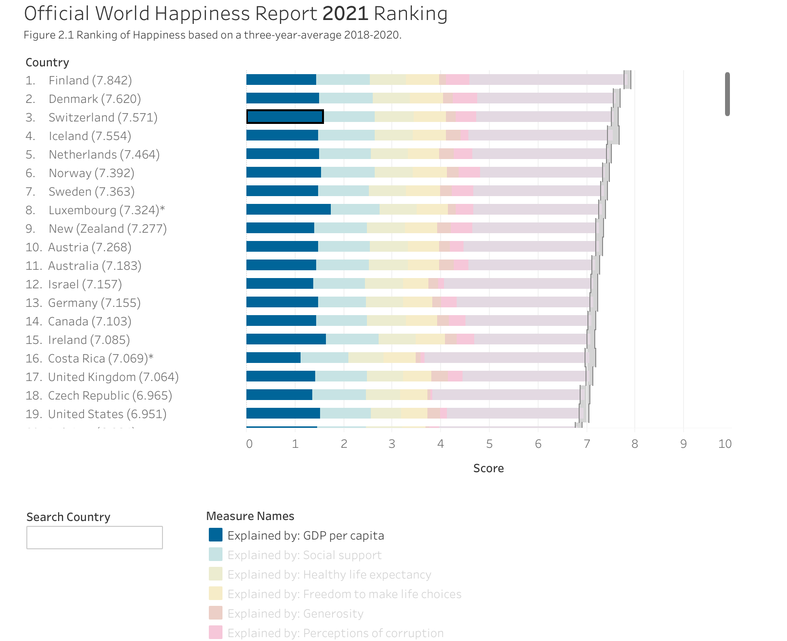
World Happiness Score
Respondent ratings to quality of life
GDP per Capita
Life Expectancy
Generosity
Social Support
Freedom to make life choices
Perception of corruption
From World Happiness Report website

Slide 31
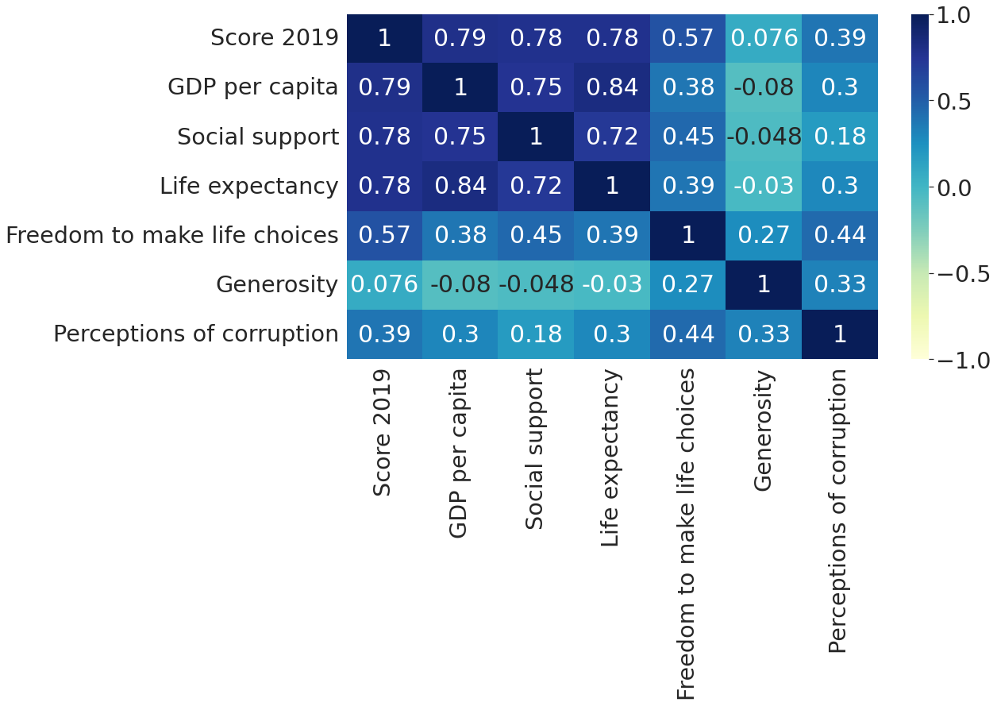
Pearson Correlation Heatmap
Observations
GDP Per Capita has highest positive correlation to Happiness Score

Slide 32
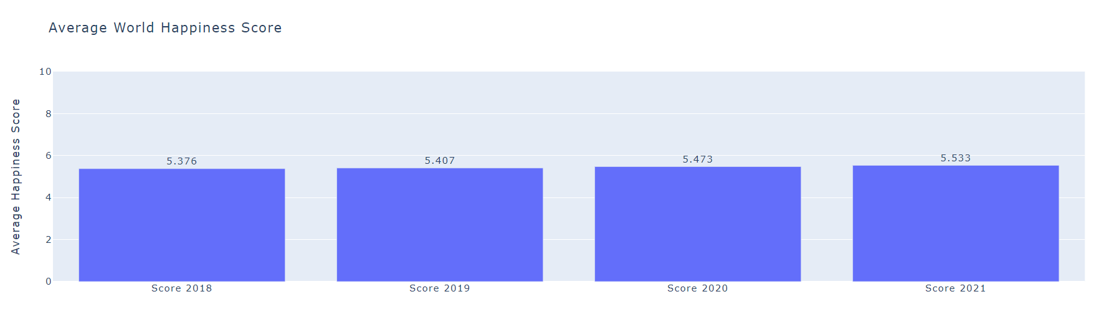
Average World Happiness Scores

Slide 33
CONCLUSION
While the COVID-19 outbreak negatively impacts most sectors, the economy has some bright spots, including new opportunities with increased demand for online sales, services, and healthcare services.
Global and Singapore economies must be closely monitored in the coming months as the COVID-19 situation remains fluid. Domestically, how the Singapore retrenchment rate performs for the rest of the year will be determined by our ability to resume economic activities safely and without a resurgence of infections in the community.
Furthermore, greater efforts must be made to encourage people to become fully vaccinated or to receive vaccines to gain better immunity to fight COVID-19, as there is still a difference in the percentage of the population vaccinated versus fully vaccinated in some countries.
A literature review could be conducted in future research to reveal current implementation strategies for Covid-19 vaccine promotion and possibly map them to a framework to determine the reasons for not taking the vaccination.
Hence, the study's goal is to inform the public about the COVID-19 situation.

Slide 34
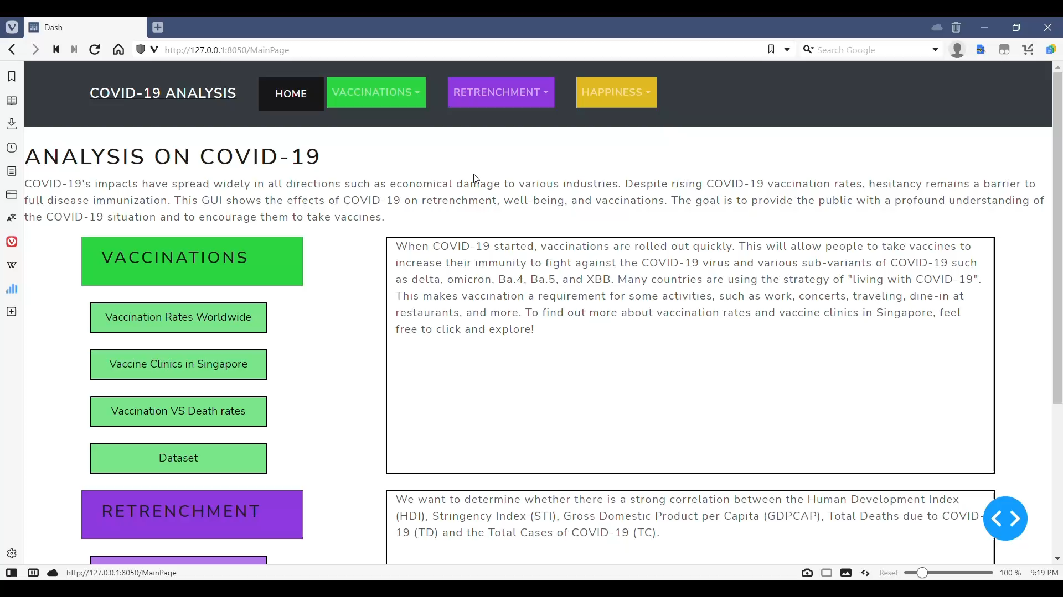
VIDEO DEMO
Notes:
INSERT VIDEO

Slide 35
THANK YOU

